Slide 1
OreSat CFC
DN
2022-06-14

Slide 2
Assumptions
Use Princeton’s TEC specification
Keep detector at -10C (263K) with body orbital average temperature of 301K
Three radiator cases: 1U, 2U, and 3U sizes

Slide 3
Thermal load
Converted detector to boundary condition @ -10C to get required heat load
Simulation suggests ~5.4W needs to be removed through the TEC to maintain -10C temperature

Slide 4
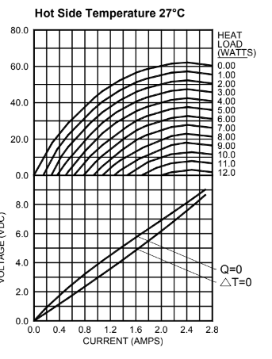

TEC power
Estimate TEC power to achieve this ΔT using TEC curves
You can see with a 5W heat load, this TEC can never achieve a 40K ΔT
We can get close by applying ~2.4A @ 7.5V
This brings total maximum refrigeration load entering thermal mass to 23.4W

Slide 5
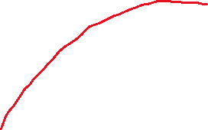
Radiator Design
Very quick and dirty radiator redesign calculations and sims give promising results
With radiator, load needed to be removed is only ~0.3W (provided radiator can be pointed to space) and ΔT of only 28K
Gives TEC power of ~1.4W and total refrigeration load of roughly 1.7W, almost a factor of 14 less than that of the heat sink design

Slide 6

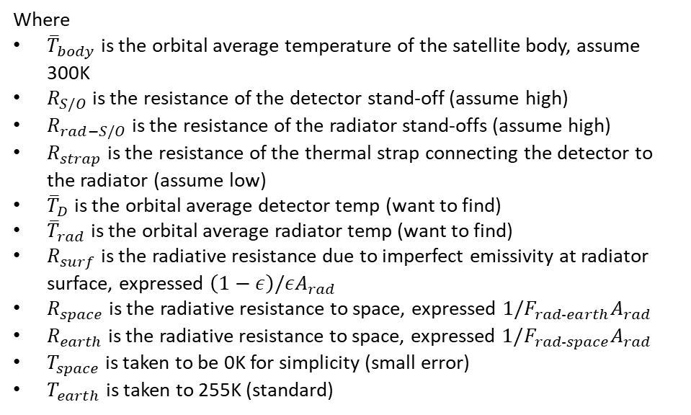










Radiator Sizing
Steady-state energy balance on radiator to determine its temperature and the detector temperature
For first pass, assume we are able to point to space (i.e. no direct sunlight on radiator)
Where
${\overline{T}}_{body}$ is the orbital average temperature of the satellite body, assume 300K
$R_{S/O}$ is the resistance of the detector stand-off (assume high)
$R_{rad−S/O}$ is the resistance of the radiator stand-offs (assume high)
$R_{strap}$ is the resistance of the thermal strap connecting the detector to the radiator (assume low)
${\overline{T}}_{D}$ is the orbital average detector temp (want to find)
${\overline{T}}_{rad}$ is the orbital average radiator temp (want to find)
$R_{surf}$ is the radiative resistance due to imperfect emissivity at radiator surface, expressed $\left(1−ε\right)/εA_{rad}$
$R_{space}$ is the radiative resistance to space, expressed $1/{F_{rad−earth}A}_{rad}$
$R_{earth}$ is the radiative resistance to space, expressed $1/{F_{rad−space}A}_{rad}$
$T_{space}$ is taken to be 0K for simplicity (small error)
$T_{earth}$ is taken to 255K (standard)
$${\overline{T}}_{body}$$
$$T_{space}$$
$$R_{S/O}$$
$$R_{rad−S/O}$$
$$R_{space}$$
$${\overline{T}}_{D}$$
$$R_{strap}$$
$${\overline{T}}_{rad}$$
$$R_{surf}$$
$$R_{earth}$$
$$T_{earth}$$

Slide 7
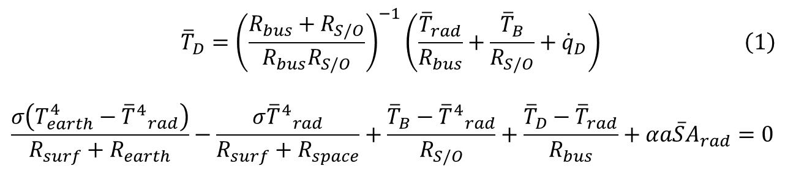
Radiator Sizing
Putting it together, ignoring albedo and radiation exchange between the back side of the radiator and body (i.e. conduction only):
$$\begin{aligned}{\overline{T}}_{D}={\left(\frac{R_{bus}+R_{S/O}}{R_{bus}R_{S/O}}\right)}^{−1}\left(\frac{{\overline{T}}_{rad}}{R_{bus}}+\frac{{\overline{T}}_{B}}{R_{S/O}}+{\dot{q}}_{D}\right)\#\left(1\right)\end{aligned}$$
$$\frac{σ\left(T_{earth}^{4}−{{\overline{T}}^{4}}_{rad}\right)}{R_{surf}+R_{earth}}−\frac{σ{{\overline{T}}^{4}}_{rad}}{R_{surf}+R_{space}}+\frac{{\overline{T}}_{B}−{{\overline{T}}^{4}}_{rad}}{R_{S/O}}+\frac{{\overline{T}}_{D}−{\overline{T}}_{rad}}{R_{bus}}+αa\overline{S}A_{rad}=0$$
Sub eqn (1) in here
2 eqns and 2 unknowns; can now use guess-and-check to find steady-state orbital average radiator temperature and then find detector temperature from there

Slide 8
Radiator Sizing
Guess-and-check and finding 0 net heat point gives us an orbital average steady-state temperature of 278K and 265K for 1- and 2U-sized radiators, respectively
Quick TD simulation validates these calculations within 1% error
Detector temperatures run very close to radiator temperature with 0.3W/K thermal strap connection

Slide 9
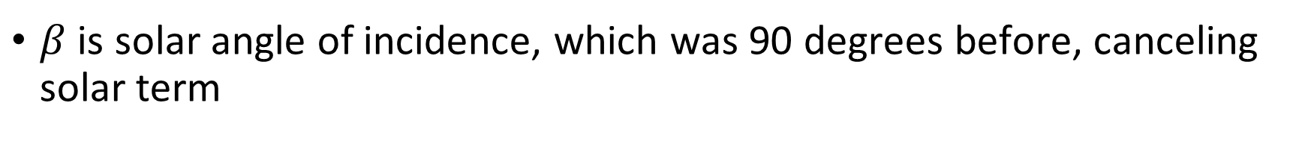
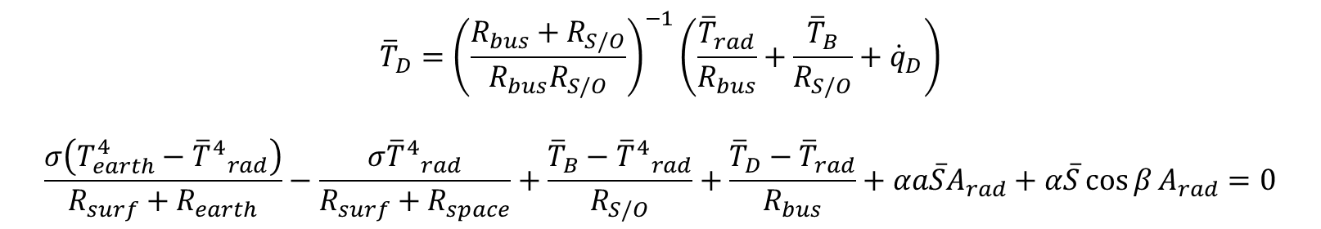
Effect of Solar Incidence on Radiator
Now repeat this for varying degrees of solar incidence
Equations now becomes:
$$\begin{aligned}{\overline{T}}_{D}={\left(\frac{R_{bus}+R_{S/O}}{R_{bus}R_{S/O}}\right)}^{−1}\left(\frac{{\overline{T}}_{rad}}{R_{bus}}+\frac{{\overline{T}}_{B}}{R_{S/O}}+{\dot{q}}_{D}\right)\#\#\#\end{aligned}$$
$$\frac{σ\left(T_{earth}^{4}−{{\overline{T}}^{4}}_{rad}\right)}{R_{surf}+R_{earth}}−\frac{σ{{\overline{T}}^{4}}_{rad}}{R_{surf}+R_{space}}+\frac{{\overline{T}}_{B}−{{\overline{T}}^{4}}_{rad}}{R_{S/O}}+\frac{{\overline{T}}_{D}−{\overline{T}}_{rad}}{R_{bus}}+αa\overline{S}A_{rad}+α\overline{S}\cos{β}A_{rad}=0$$
$β$ is solar angle of incidence, which was 90 degrees before, canceling solar term

Slide 10
Effect of Solar Incidence on Radiator
Shows up to 14˚ C difference in radiator temperature depending on attitude

Slide 11
Conclusions
If attitude is properly controlled, early simulations suggest that detector can be passively cooled to within a couple degrees of the target temperature
A TEC can then be used (perhaps with ability to reverse current) to stabilize temperature at low power
(Based on CAD I had access to) Cu thermal mass was about 1kg
With radiator and thermal strap, the thermal system is roughly estimated between 150 and 350g

